Slide 1
Statistics for Data Science

Slide 2

HELLO!
I am Arpit Jain
I am here because Data Science is my passion and I love sharing my expertise with people.

Slide 3
Agenda
1
Role Of Statistics
Descriptive Vs Inferential Statistics
Measurement of CT, Dispersion, Distribution
Correlation & Causation
Hypothesis Testing
ANOVA

Slide 4
Role Of Statistics
Data Understanding and Visualization:
Statistics enables data exploration, summarization, and visualization for initial insights.
Predictive Modeling and Machine Learning:
Form the foundation of predictive analytics and machine learning algorithms.
Hypothesis Testing and A/B Testing:
Empowers data-driven decision-making through hypothesis testing and A/B testing.
Ethical Data Use and Bias Mitigation:
Aids in detecting and addressing bias, ensuring fairness in algorithmic decisions.
Model Evaluation and Continuous Improvement:
Assess model performance, allowing for ongoing refinement and optimization.
Statistics Statistics
Statistical metrics assess model performance, allowing for ongoing refinement and optimization.

Slide 5
Descriptive Vs Inferential
Descriptive
Inferential
Central Tendency
Hypothesis Testing
Variability
Chi Square tests
Frequency
Confidence Intervals

Slide 6
Measurement of Central Tendency
Mean
Median
Mode

Slide 7
Measurement of Dispersion
Range
Standard Deviation
Variance

Slide 8
Measurement of Frequency/Distribution
Histogram
Box Plot

Slide 9
Correlation Vs Causation
Correlation and causation are two concepts in statistics and research that are often confused but have distinct meanings and implications
Correlation
Correlation refers to a statistical relationship or association between two or more variables. It measures the degree to which changes in one variable are associated with changes in another variable.
Ex ->
An example of correlation is the positive relationship between ice cream sales and the number of drowning incidents. Both variables tend to increase during the summer months, but one does not cause the other. It could be influenced by a third variable, temperature.

Slide 10
Correlation Vs Causation
Correlation and causation are two concepts in statistics and research that are often confused but have distinct meanings and implications
Causation
Causation implies a cause-and-effect relationship between variables. It suggests that changes in one variable directly result in changes in another variable.
Ex ->
An example of causation is the relationship between smoking and lung cancer. Numerous studies have demonstrated that smoking is a cause of lung cancer through controlled experiments and extensive research.

Slide 11
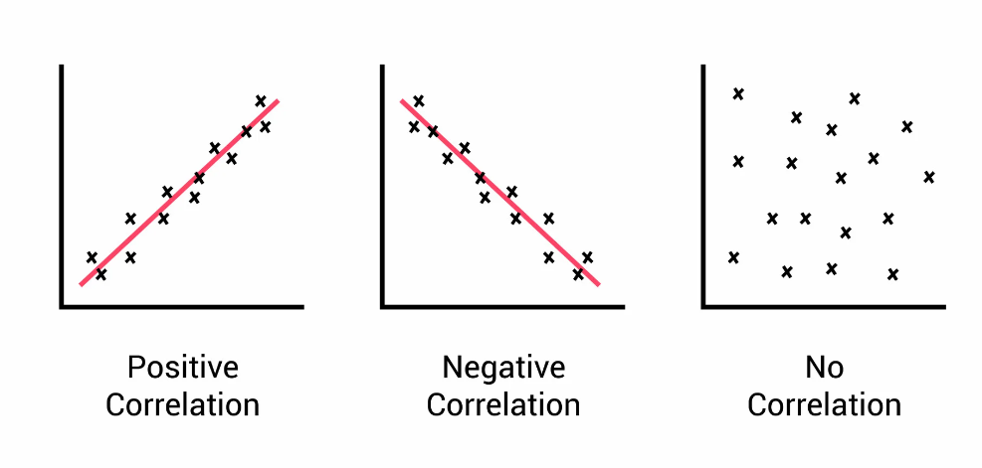
Pearson Correlation
Correlation between 2 variables. Denoted as ‘r’
Ranges from -1 to +1

Slide 12
Spearman Correlation
Spearman's rank correlation coefficient, often denoted as "ρ" (rho), is a non-parametric measure of statistical dependence or correlation between two variables.
Unlike Pearson's correlation coefficient, which measures linear relationships, Spearman's correlation is based on the ranks of the data values.

Slide 13
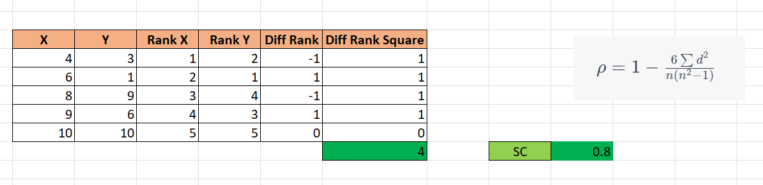
Spearman Correlation

Slide 14
Test Statistics – T & Z stats
T-Statistics:
Used when the sample size is small (typically less than 30) or when the population standard deviation is unknown.
Requires an estimate of the population standard deviation based on the sample data.
Follows the t-distribution, which has heavier tails compared to the standard normal (z) distribution.
The t-distribution becomes more similar to the z-distribution as the sample size increases.
Z-Statistics:
Used when the sample size is large (typically greater than 30) or when the population standard deviation is known.
Does not require an estimate of the population standard deviation as it is known.
Follows the standard normal (z) distribution, which has a mean of 0 and a standard deviation of 1.
The z-distribution is symmetric and has thinner tails compared to the t-distribution.

Slide 15
Z Score
Z-Score for a Population Mean (Known Population Standard Deviation):
Z = (X - μ) / (σ / √n)
Where:
Z is the z-score
X is the sample mean
μ is the population mean
σ is the population standard deviation
n is the sample size

Slide 16
Z Score - Example
Let's consider a scenario where a retail chain wants to determine whether the average waiting time in one of their stores is significantly different from the company's standard average wait time. The company's standard average wait time is known to be 5 minutes, with a population standard deviation of 1 minute.
Population Mean (μ): 5 minutes (known)
Population Standard Deviation (σ): 1 minute (known)
Sample Mean (x̄): 4.8 minutes (calculated from the sample data)
Sample Size (n): 40 (given)
Z-Score for Population Mean (Known Population Standard Deviation):
Z = (x̄ - μ) / (σ / √n)
Z = (4.8 - 5) / (1 / √40)

Slide 17
Z Score - Example
Interpretation:
The calculated Z-Score is approximately -1.264. This negative Z-Score indicates that the sample mean wait time is 1.264 standard deviations below the population mean (company's standard average wait time).
Hypothesis Testing: The retail chain can now use the Z-Score to perform a hypothesis test. They can compare the Z-Score to the critical value corresponding to their desired level of significance (e.g., 5% level of significance) from the standard normal distribution table. If the Z-Score falls outside the critical region, they may reject the null hypothesis, indicating that the average wait time in the store is significantly different from the company's standard average wait time. Otherwise, they may fail to reject the null hypothesis, suggesting no significant difference.

Slide 18
Hypothesis Testing
A hypothesis is a potential explanation for something that happens or that you observe and think to be true.
It can also be used to determine the relationship between two or more variables that you think might be related to each other.
If I replace the battery in my car, then my car will get better gas mileage.
If I eat more vegetables, then I will lose weight faster.
If I add fertilizer to my garden, then my plants will grow faster.
If I brush my teeth every day, then I will not develop cavities.
If I take my vitamins every day, then I will not feel tired.
Potential Examples

Slide 19
Hypothesis Testing
Hypothesis testing typically involves a five step process:
Formulating Hypothesis
Identifying Null Hypothesis
Identifying Alternate Hypothesis
Conducting experiment for hypothesis testing
Evaluating Results

Slide 20
Hypothesis Testing
Formulating Hypothesis
An office Management is thinking of ways to reduce the off-site breaks of the employees. A leader suggested that employees took a break for food and proposed providing snacks to employees in the office.
Here the hypothesis is:
“If an office provides snacks, employees will take fewer off-site breaks.”

Slide 21
Hypothesis Testing
Null Hypothesis
A null hypothesis is the default position that assumes that variables have no relation to each other.
It is denoted as H₀.
Null hypothesis (H₀): The status quo
Continuing with previous example:
Hypothesis: “If an office provides snacks, employees will take fewer off-site breaks”
Null Hypothesis(H₀): The number of off-site breaks employees take is not related to the availability of food.

Slide 22
Hypothesis Testing
Alternate Hypothesis
Find the null hypothesis' alternate result that contradicts it.
Both the null hypothesis and the original hypothesis are different from the alternative hypothesis.
If, as in the previous illustration, the original hypothesis is that if an office provides snacks, employees will take fewer off-site breaks.
The null hypothesis is that the number of off-site breaks taken by employees is not correlated with the availability of snacks.
Then a potential alternate hypothesis would be that if an office provides snacks, employees will take more off-site breaks to obtain various snacks they prefer.

Slide 23
Hypothesis Testing
Conduct Experiment
Create a plan for experimenting with gathering all necessary materials to complete your testing. Include the experiment stages and procedures for gathering materials, observing, taking notes, and tracking progress. Then, closely adhere to that plan to make sure the hypothesis is put to the test.
Consider the claim that workers will take fewer off-site breaks if an office offers snacks. This is how an experiment for this theory might look:
Gather supplies, such as office snacks, a pen and paper, and a spreadsheet for keeping notes.
Count the number of employees who leave the office for breaks during the first week.
For the upcoming week, set up snacks in the workplace every day.
Count the number of workers who choose to take an off-site break versus those who choose the offered office snacks.

Slide 24
Hypothesis Testing
Evaluating Result
Review your findings and contrast them with the forecasts contained in your initial hypothesis.
This aids in determining whether the experiment supported the null or alternative hypotheses rather than the original hypothesis, which may have been correct.
The results of a hypothesis test can be used to form new observations and possibly a new hypothesis.

Slide 25
Hypothesis Formulation
The first step of hypothesis testing is the formulation of the null and alternate hypotheses for a given situation. Let’s learn how to do this through different examples.
But in some instances, if your claim statement has words like “at least”, “at most”, “less than”, or “greater than”, you cannot formulate the null hypothesis just from the claim statement (because the claim doesn’t need to be always about the status quo).
You can use the following rule to formulate the null and alternate hypotheses:
The null hypothesis always has the following signs: = OR ≤ OR ≥
The alternate hypothesis always has the following signs: ≠ OR > OR <

Slide 26
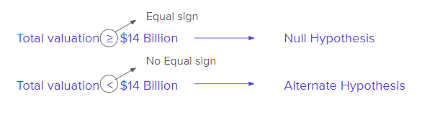
Hypothesis Example
Situation 1: Amazon Ph claimed that its total valuation in December 2016 was at least $14 billion. Here, the claim contains the ≥ sign (i.e. the at least sign), so the null hypothesis is the original claim.
The hypothesis in this case can be formulated as:

Slide 27
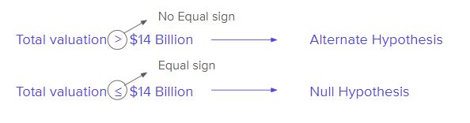
Hypothesis Example
Situation 2: Amazon Ph claimed that its total valuation in December 2016 was greater than $14 billion. Here, the claim contains the > sign (i.e. the ‘more than’ sign), so the null hypothesis is the complement of the original claim.
The hypothesis in this case can be formulated as:

Slide 28
Hypothesis Decision Making
Claim/Hypothesis: Average time taken by the employees to reach the office is 70 minutes.
Step-1: Null Hypothesis
(H₀): μ = 70
Step-2: Alternate Hypothesis
(H₁) : μ ≠ 70
Let’s say an independent team selected some random people from the company and calculated the average as 50 minutes. Now the independent team wants to understand if the company’s claim is wrong or did they get 50 minutes by random chance, and employees indeed take an average of 70 minutes to reach the office.

Slide 29
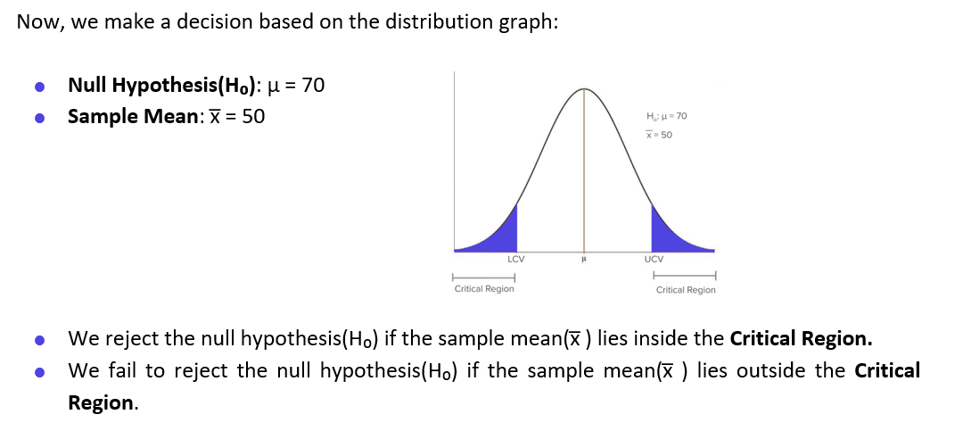
Hypothesis Decision Making

Slide 30
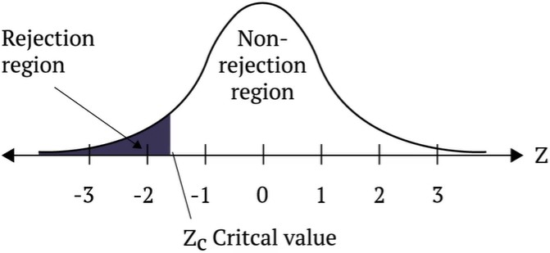
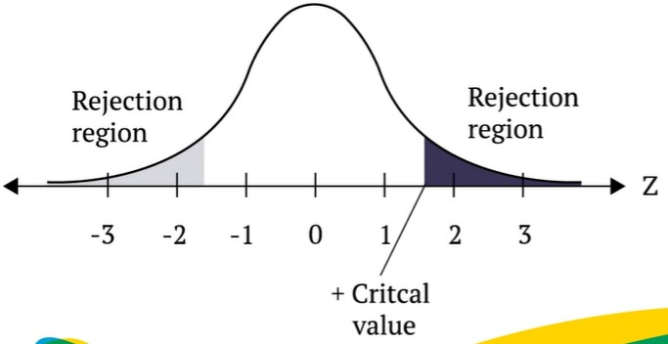

Hypothesis Rejection Regions
The Rejection Region
The Rejection Region
Refers to the range of values for which the null hypothesis is not possible
Left - tailed test:
Right-tailed test:
Two-tailed test:
H₀: µ ≥ k
H_{a}: µ < k
H₀: µ ≤ k
H_{a}: µ > k
H₀: µ = k
H_{a}: µ ≠ k

Slide 31
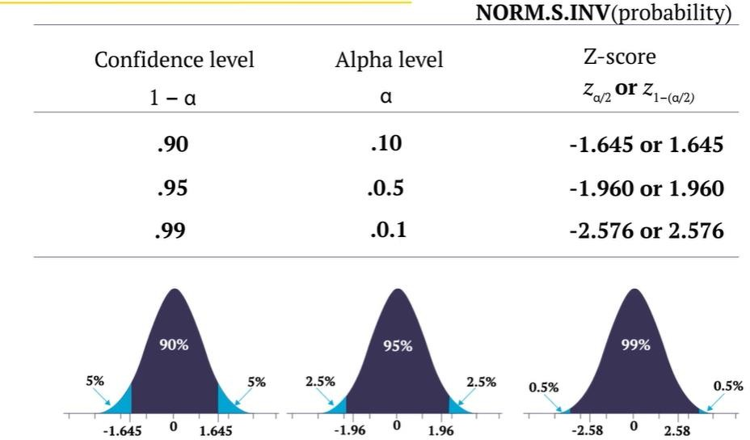
Significance Levels
The Significance Level and Z-Score

Slide 32
Hypothesis – Case Study
Let's say a country experiences 350mm of rain each year, with a standard deviation of 90. Now, we sampled 36 cities across the nation and came up with the average sample mean(x) of 370.16. At a significance level of 5%, we must reject or fail to reject the claim.
Now that we have this knowledge, we must determine the critical values.
Step-1: Formulating the Hypothesis
Null Hypothesis (H₀): μ = 350
Alternate Hypothesis (H₁) ≠350
Since H₁ contains ≠ sign, the test will be of a Two-tailed test with a critical region on both sides of the normal distribution.

Slide 33
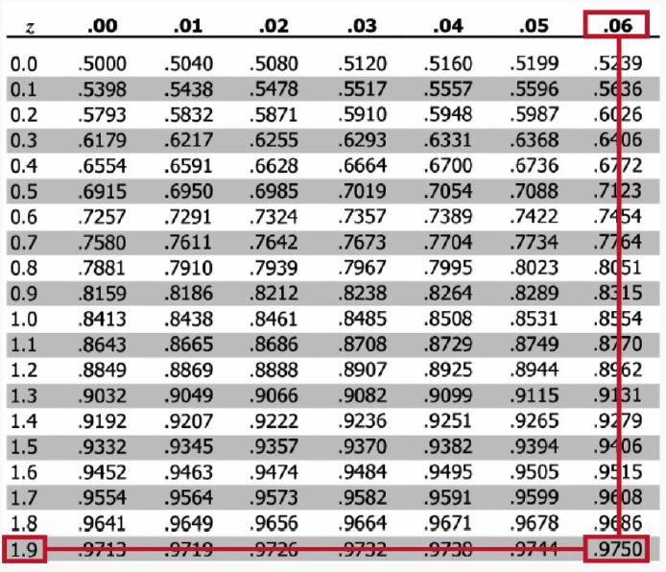
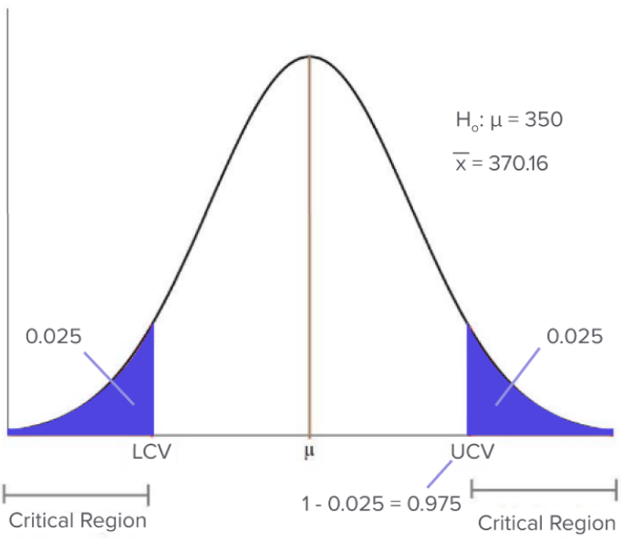
Hypothesis – Case Study
Step-2: Find the Zc value
Given α = 0.05,
since it is a two-tailed test, the critical region lies on both sides of the distribution, so the significance level will be 0.025 on both sides.
That means the area of the critical region on the right side would be 0.025.
This means the area till UCV (Cumulative Probability till that point) would be 1–0.025 = 0.975.

Slide 34
Hypothesis – Case Study
Step-2: Find the Zc value
Given α = 0.05,
since it is a two-tailed test, the critical region lies on both sides of the distribution, so the significance level will be 0.025 on both sides.
That means the area of the critical region on the right side would be 0.025.
This means the area till UCV (Cumulative Probability till that point) would be 1–0.025 = 0.975.
The Z score will be 1.96. Zc = 1.96

Slide 35
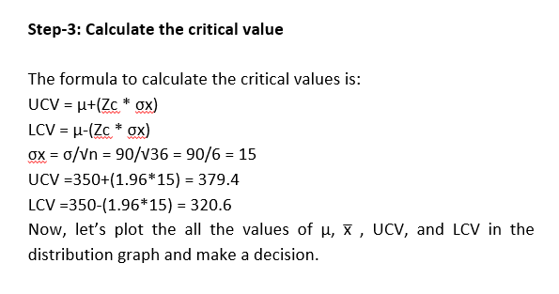
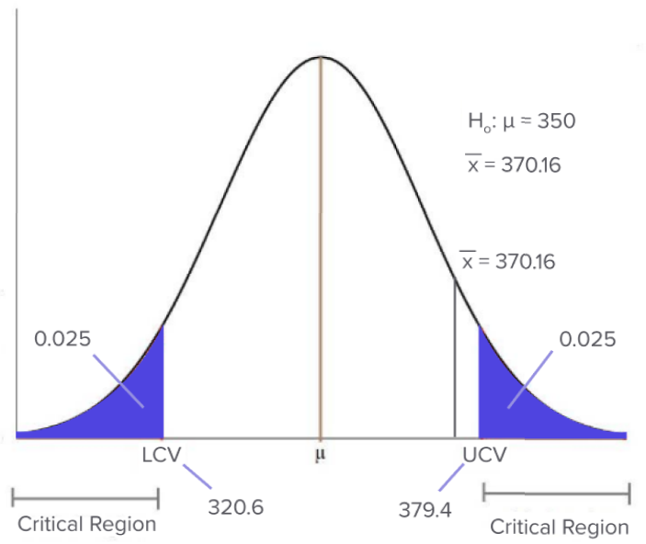
Hypothesis – Case Study
Step-4: Make a Decision
As the Sample Mean lies outside the Critical Region, we fail to reject the null hypothesis.

Slide 36
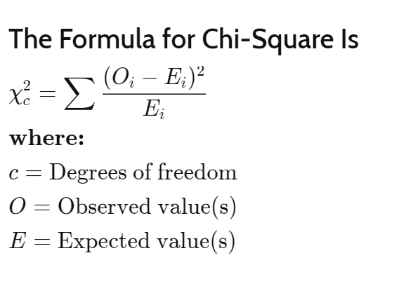
Chi Square Test
The chi-square test for independence is a statistical test used to determine whether there is a significant association between two categorical variables.
It assesses whether the observed frequency distribution of the data differs from what would be expected if the two variables were independent of each other.

Slide 37
Chi Square Example
Blog Link
Chi Square Ref Table

Slide 38
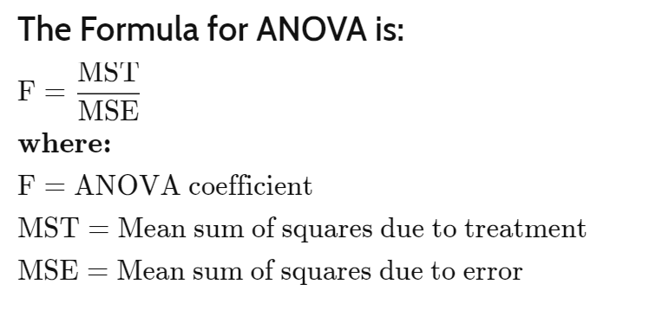
ANOVA
ANOVA, or Analysis of Variance, is a statistical technique used to compare means (averages) of two or more groups or categories to determine if there are significant differences among them.
It helps you answer the question: "Are the means of these groups significantly different, or could the observed differences be due to random chance?"

Slide 39
ANOVA - Example
Blog Link
F Table

Slide 40

Thank You

